Slide 1




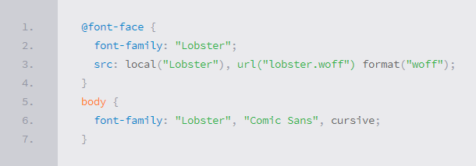
CSS Presentation
CSS Typography, Fonts, Spacing, Borders, Backgrounds, Opacity
Web Fundamentals
SoftUni Team
Technical Trainers
Software University
http://softuni.bg

Slide 2

Table of Contents
font-family: Arial;
Text-Related Properties
Fonts, Colors, Text Overflow
Borders
Backgrounds
Background color
Background image
Gradient Background
Opacity
color: green;
line-height: 50px;
border: 0;
background: url('lines.png');
color: #2aa0bd;
opacity: 0.75;

Slide 3

Text-Related CSS Properties

Slide 4
CSS Rules for Fonts and Paragraphs
color – specifies the color of the text, e.g. #A5E733
font-size – size of font: xx-small, x-small, small, medium, large, x-large, xx-large, smaller, larger or numeric value
Have different values in different browsers – Use pixels, em, rem, points
font-family – comma separated font names
Example: "Times New Roman", Verdana, sans-serif, etc.
The browser loads the first one that is available
There should always be at least one generic font, e.g. "sans-serif“, “serif”, “cursive”, “fantasy”, “monospace”
http://google.com/fonts - Google free fonts
font-weight – can be normal, bold, bolder, lighter or a number in range [100 … 900]

Slide 5
CSS Rules for Fonts and Paragraphs (2)
font-style – styles the font (normal, italic, oblique)
text-decoration – decorates the text
Values: none, underline, line-trough, overline, blink
text-align – defines the alignment of text or other content
Values: left, right, center, justify
line-height – defines the height of the font, e.g. 20px
text-indent – indents the start of the paragraph
letter-spacing, word-spacing
text-transform – uppercase, lowercase, capitalize

Slide 6
Shorthand Font Property
font
Shorthand rule for setting multiple font properties
is equal to writing this:
font: italic normal bold 12px/16px verdana
font-style: italic;
font-variant: normal;
font-weight: bold;
font-size: 12px;
line-height: 16px;
font-family: verdana;

Slide 7
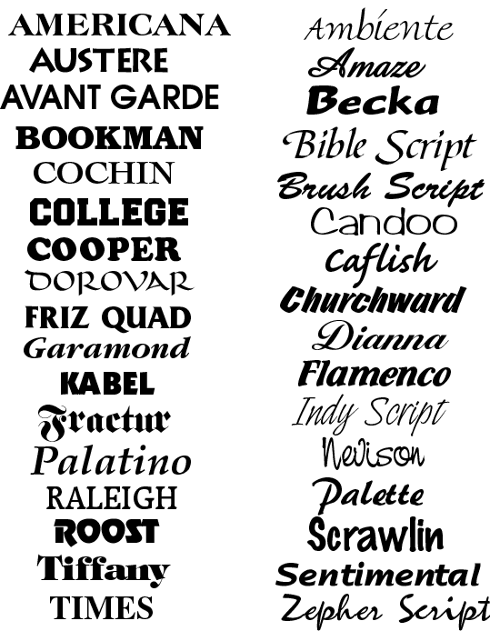




Text-Related Properties
Live Demo

Slide 8

Font Embedding
Use @font-face to declare external fonts
Call font with font-family
Use font embedding instead of images
Supported font formats:
TTF, OTF, WOFF
@font-face {
font-family: SketchRockwell;
src: url('SketchRockwell-Bold.ttf');
}
body {
font-family: SketchRockwell;
font-size: 3.2em;
}

Slide 9


Text Shadow
The text-shadow property applies a shadow to the text
Does not alter the size of a box
text-shadow: <horizontal-distance> <vertical-distance> <blur-radius> <shadow-color>;
text-shadow: 2px 2px 7px #000000;

Slide 10



Text Overflow
Specifies what should happen when text overflows the containing element
ellipsis – displays ellipses (…) to represent the clipped text
clip – default value, clips the text
string – displays custom string as clipped text
Only supported by Firefox
text-overflow: ellipsis;
text-overflow: clip;
text-overflow: '..';

Slide 11
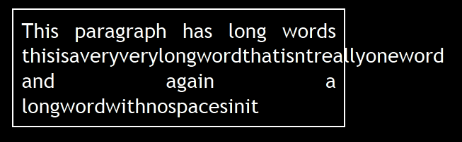
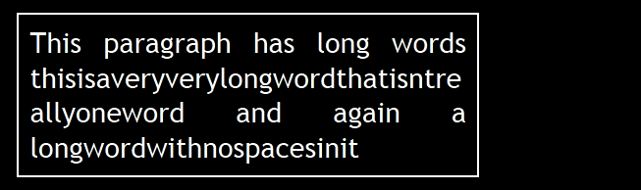
Word Wrapping
Allows long words to be broken and wrap onto the next line
Possible values:
Supported in all major browsers
word-wrap: normal;
word-wrap: break-word;

Slide 12
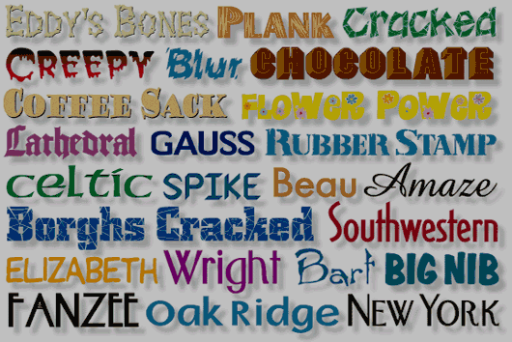
More Fonts
Live Demo

Slide 13
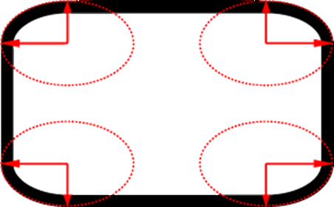
Borders

Slide 14
Borders
border-width: thin, medium, thick, numeric (e.g. 10px)
border-color: color alias or RGB value, e.g. #AAFFEE
border-style: none, hidden, dotted, dashed, solid, double, groove, ridge, inset, outset
Can be defined separately for left, top, bottom and right
border-top-style, border-left-color, border-bottom-color, border-right-color

Slide 15
Border Shorthand Property
border: shorthand rule for setting border properties at once:
is equal to writing:
Specify different borders for the sides via shorthand rules:
border-top, border-left, border-right, border-bottom
Skip the border: border:none or border:0
border: 1px solid red;
border-width: 1px;
border-color: red;
border-style: solid;

Slide 16

Borders
Live Demo

Slide 17

Box Shadow
Allows to easily implement multiple drop shadows (outer or inner) on box elements
Specifying values for offset, size, blur and color
Example:
box-shadow: 10px 10px 5px #888;

Slide 18
Rounded Corners
Rounded corners are a part of CSS 3
Supported in all major browsers
Done by the border-radius property
Three ways to define corner radius:
border-radius: [<length>|<%>][<length>|<%>]?
border-radius: 15px;
border-radius: 15px 15px 15px 10px;
border-radius: 15px 20px;

Slide 19

Other Border Styles
Live Demo

Slide 20

Background Properties

Slide 21
Backgrounds
background-image
URL of image to be used as background, e.g.:
background-color
E.g. #6DB3F2
background-repeat
repeat-x, repeat-y, repeat, no-repeat
background-attachment
fixed / scroll – background scrolls with the text / stays fixed
background-image: url('background.gif');

Slide 22
Backgrounds (2)
background-position: specifies vertical and horizontal position of the background image
Vertical position: top, center, bottom
Horizontal position: left, center, right
Both can be specified in percentage or other numerical values
Examples:
background-position: top left;
background-position: -5px 50%;

Slide 23
Background Shorthand Property
background: shorthand for setting all background properties:
is equal to writing:
Some browsers will not apply BOTH color and image for background if using the shorthand rule
background: #FFF0C0 url("back.gif") no-repeat fixed top;
background-color: #FFF0C0;
background-image: url("back.gif");
background-repeat: no-repeat;
background-attachment: fixed;
background-position: top;

Slide 24
Background-image or <img>?
Background images allow moving images out from the HTML
Leads to less code
More content-oriented approach
Images to move to the CSS
All images that are not part of the page content
Images used only for "beautification"
Images to leave in the HTML
Part of the page content

Slide 25
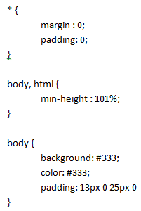

Background Styles
Live Demo

Slide 26

Gradient Backgrounds
Gradients are smooth transitions between two or more colors
CSS gradients can replace images and reduce download time
Lots of gradient generators on the Web
Create a more flexible layout, and look better while zooming
background: linear-gradient(#0000FF, #FFFF00);

Slide 27


Gradient Background
Live Demo

Slide 28



Multiple Backgrounds
CSS3 allows multiple background images
Simple comma-separated list of images
Comma separated list for the other properties
background-image: url(sheep.png), url(grass.png);

Slide 29

Multiple Backgrounds
Live Demo

Slide 30

Opacity

Slide 31
Opacity
opacity: specifies the opacity of the element
Floating point number from 0 to 1
For old Mozilla browsers use –moz-opacity
For IE use filter:alpha(opacity=value) where value is from 0 to 100; also, "binary and script behaviors" must be enabled and hasLayout must be triggered, e.g. with zoom:1
opacity: 0.5;

Slide 32

Opacity
Live Demo

Slide 33

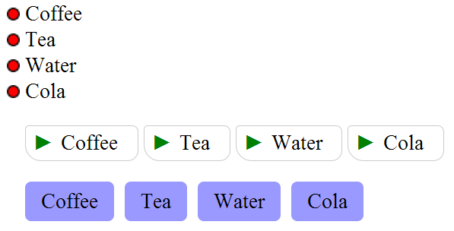
Styling Lists
Live Demo

Slide 34
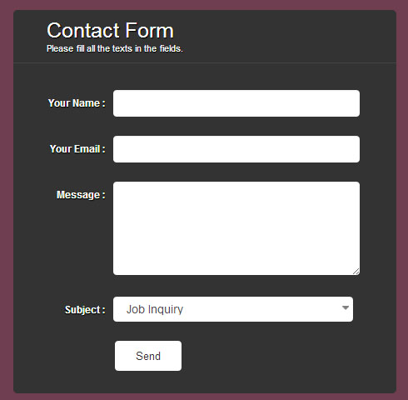
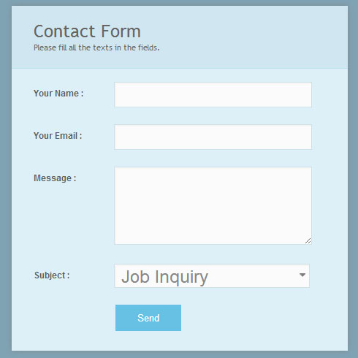
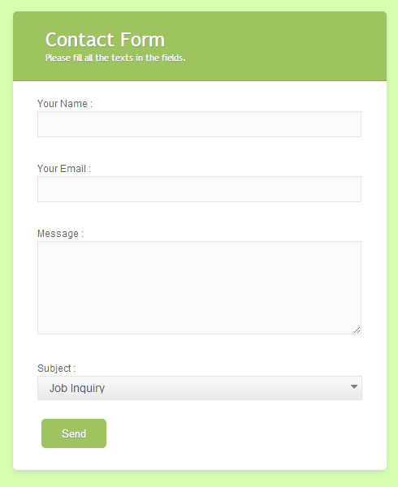
Styling Forms
Live Demo

Slide 35
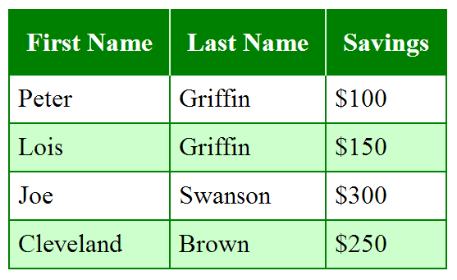
Styling Tables
Live Demo

Slide 36

Summary
Text-related properties define
Fonts, colors, text overflow, paragraphs
Borders
Rounded corners
Backgrounds
Images, gradients, multiple images
Opacity – 0%...100%
Styling lists, forms, tables

Slide 37









CSS Presentation
https://softuni.bg/courses/web-fundamentals/

Slide 38
License
This course (slides, examples, demos, videos, homework, etc.) is licensed under the "Creative Commons Attribution-NonCommercial-ShareAlike 4.0 International" license
Attribution: this work may contain portions from
"HTML Basics" course by Telerik Academy under CC-BY-NC-SA license
"CSS Styling" course by Telerik Academy under CC-BY-NC-SA license

Slide 39





Free Trainings @ Software University
Software University Foundation – softuni.org
Software University – High-Quality Education, Profession and Job for Software Developers
softuni.bg
Software University @ Facebook
facebook.com/SoftwareUniversity
Software University @ YouTube
youtube.com/SoftwareUniversity
Software University Forums – forum.softuni.bg

